Slide 1
The Flexible Job Shop Scheduling Algorithm
Notes:
The flexible job shop scheduling algorithm is an extension of the job shop scheduling problem: an NP-hard algorithm that attempts to assign jobs to resources in the most optimized fashion.

Slide 2


Jobs {$J_{1}, J_{2}, …, J_{n}\}$
Machines {$M_{1}, M_{2}, …, M_{m}\}$
Job 1
Every job is done by
every machine exactly once
Machine 1
Job 2
$$M_{1}\underset{→}{\text{yields}}$$
𝑀_1 →┴"yields"
$$J_{1}$$
𝐽_1
$$J_{3}$$
𝐽_3
$$J_{2}$$
𝐽_2
Machine 2
.
.
.
.
.
.
Job n
Machine m
Notes:
The traditional algorithm takes n jobs and m machines, and finds the most optimal way to run all the jobs through any individual machine for every machine. For example, the algorithm may find that the most optimal way to run three jobs through machine 1 is to first run job 1, then job 3, then job 2. However, (next slide)

Slide 3
Jobs {$J_{1}, J_{2}, …, J_{n}\}$
Machines {$M_{1}, M_{2}, …, M_{m}\}$
Job 1
Every job is done by
every machine exactly once
Machine 1
Job 2
$$M_{2}\underset{→}{\text{yields}}$$
𝑀_2 →┴"yields"
$$J_{2}$$
𝐽_2
$$J_{1}$$
𝐽_1
$$J_{3}$$
𝐽_3
Machine 2
.
.
.
.
.
.
Job n
Machine m
Notes:
Machine 2 would run the same jobs most optimally by first running job 2, then job 1, then job 3. But this type of problem is not very representative of a real-world situation. Any standard shop such as a manufacturing plant or a kitchen will have machines that cannot do some of the jobs. Furthermore one would want to run multiple jobs or tasks on multiple machines in parallel.

Slide 4
Making it flexible
Task 1
Task 2
Task n
. . . . .
Machine 1
Machine 2
Machine m
. . . . .
Notes:
The flexible job shop scheduling algorithm takes several jobs that can be completed by one or more machines. Timing and sequencing must be kept in mind as certain tasks may be dependent on others being completed. We must determine what the most optimal way to choose a task for a machine and sequence is such that the cost of running the entire process is minimized.

Slide 5
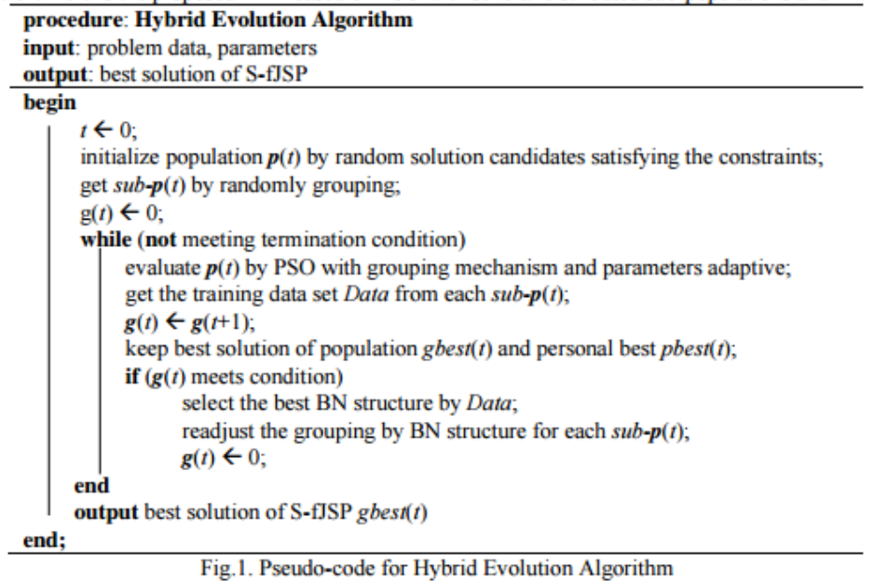
Notes:
We go into two extensions relevant to the algorithm. First, this algorithm uses evolutionary approximation methods to approximate the answer. Rather than explain how Bayesian and Evolutionary optimization works, there will be a very fast and condensed example of how the algorithm would run the task of optimizing making a Thanksigivng meal. Secondly, a critical flaw was found in the published paper about the flexible job shop scheduling algorithm. We will show that the goal of optimization through approximation was not achieved.

Slide 6
Our Example
Machines
Turkey (tasks: cook, wash)
Mashed Potatoes (tasks: mash)
Pie (tasks: stir, mix, cook, etc)
Persons: Can chop, stir, mix, prep, add, etc
Oven: Can roast, bake, broil, boil and simmer in parallel
Stove: Can steam, boil, and roast
Jobs

Slide 7
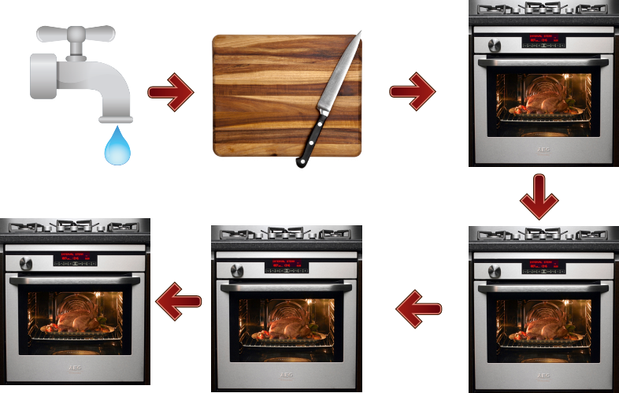
Ideal Turkey Sequence

Slide 8
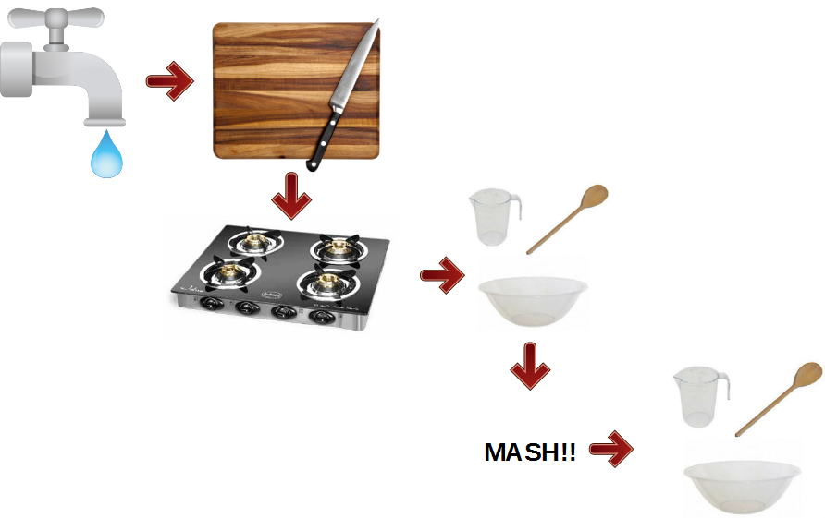
Ideal Mashed Potatoes Sequence

Slide 9
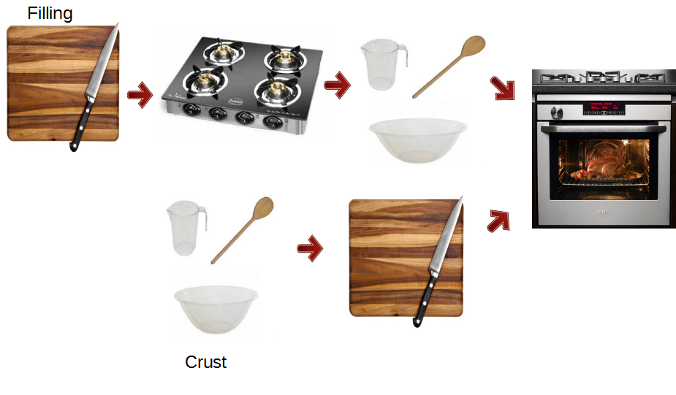
Ideal Pie Sequence

Slide 10
The Algorithm: Step 0
Roll out pie dough
Chop potatoes
Cook turkey
Wash turkey
Wash potatoes
Cook pie
Prep turkey
Add filling to dough
Stir potatoes
Mash potatoes
Boil potatoes
Mix pie filling
Stir pie filling
Mix pie dough
Cook pie filling

Slide 11
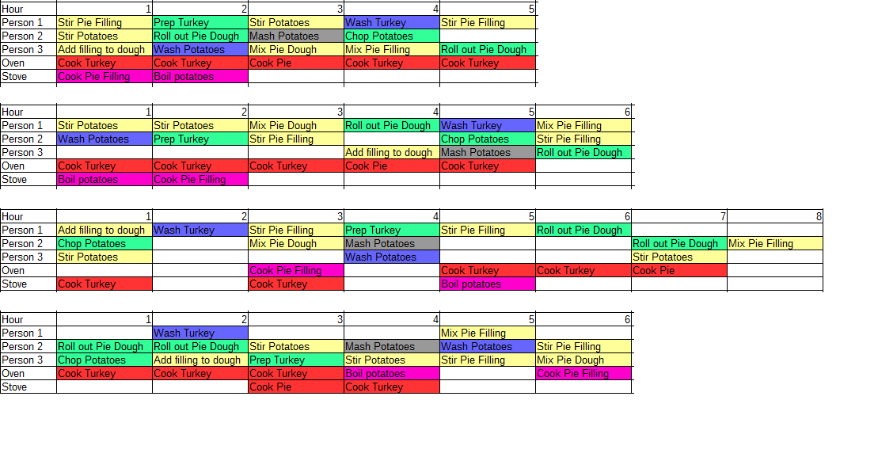
The Algorithm: Step 1 Generate Random Orderings
Add in tables

Slide 12
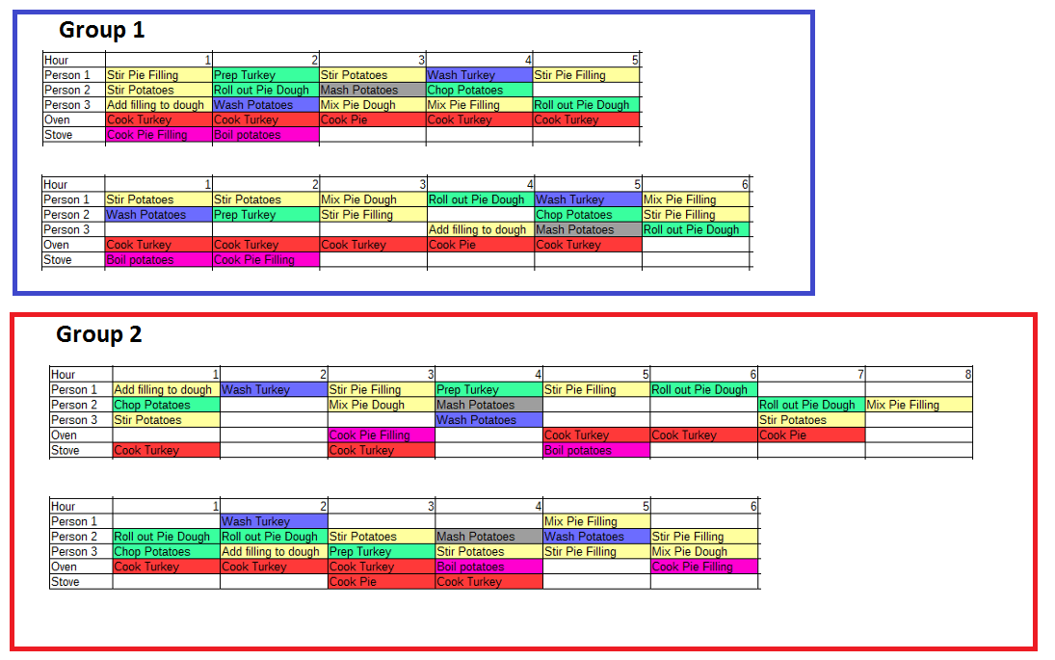
The Algorithm: Step 2 Randomly Group Orderings
Add in tables

Slide 13
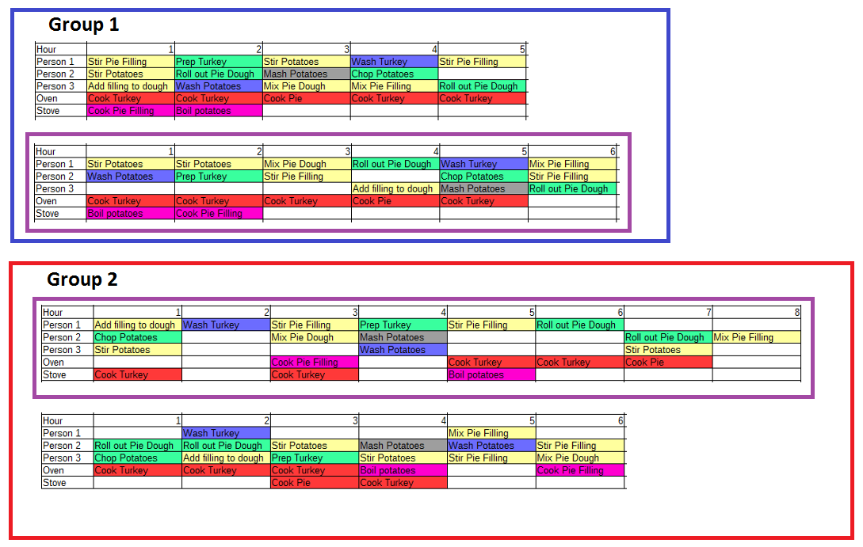
The Algorithm: Step 3 Select best individuals using fitness function
Add in tables

Slide 14
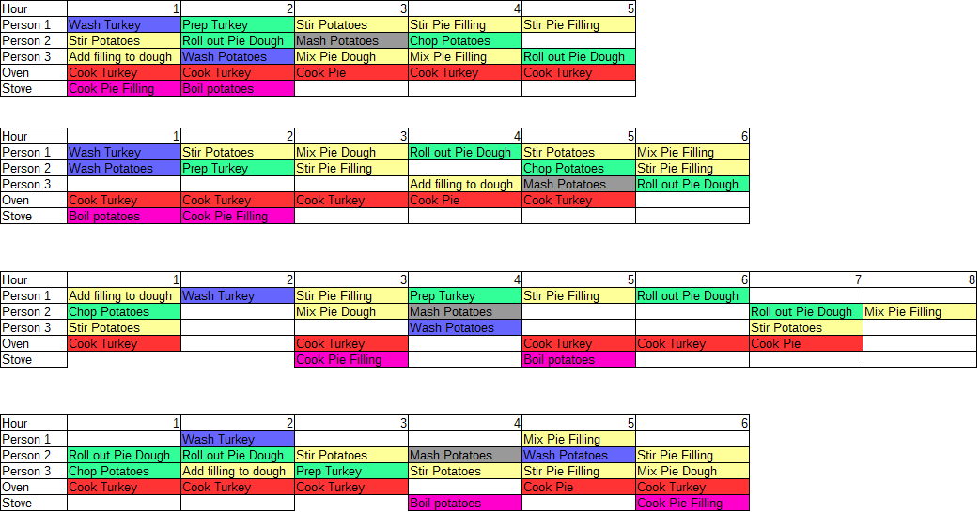
The Algorithm: Step 4 “Push” all individuals in the right direction
Add in tables

Slide 15
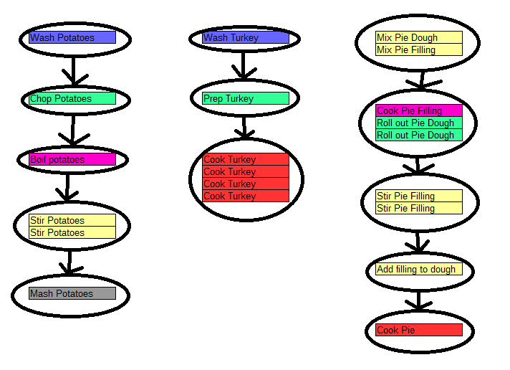
The Algorithm: Step 5 Select best Bayesian network
Add in tables

Slide 16
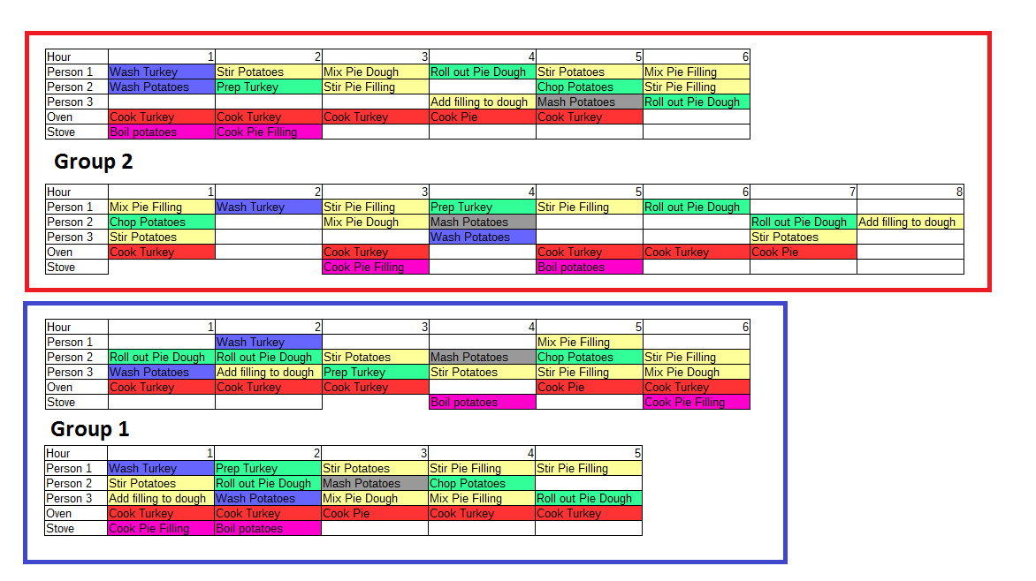
The Algorithm: Step 6 Regroup orderings using Bayesian Network
Add in tables

Slide 17
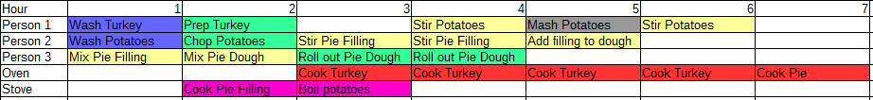
Loop until a good solution is reached

Slide 18
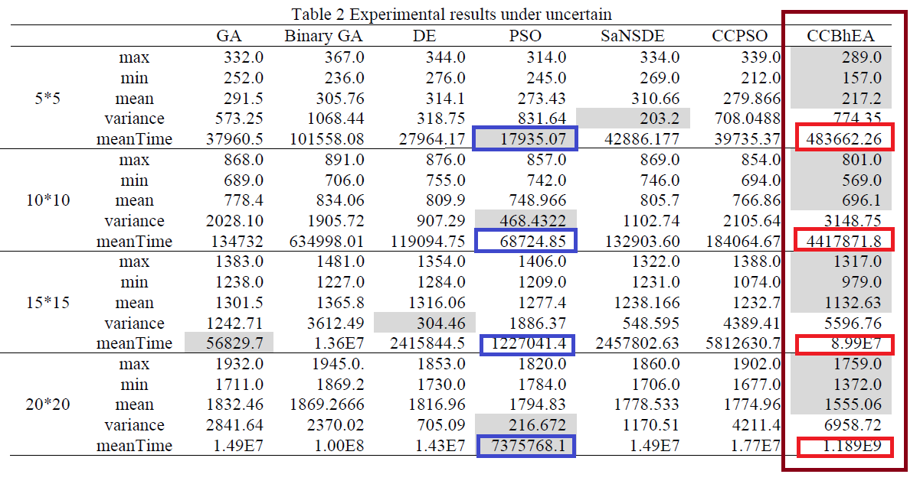
Algorithm Analysis and Critique

Slide 19
Mean Time Per Generation
 | Mean Time | Mean Generations | Mean Time/Generation
GA | 37960.5 | 291.5 | 130.2
Binary GA | 101558.1 | 305.8 | 332.1
DE | 27964.2 | 314.1 | 89.0
PSO | 17935.1 | 273.4 | 65.6
SaNSDE | 42886.2 | 310.7 | 138.0
CCPSO | 39735.4 | 279.9 | 142.2
Hybrid Evolutionary Algorithm | 483662.3 | 217.2 | 2226.8

Slide 20
Analysis And Critique
Learning Bayesian Networks is an NP-Complete problem

Slide 21
Necessary Fixes To Their Approach
Prove their algorithm was faster than a specific solution
Prove their algorithm produced a better approximation than other evolutionary approaches
Prove their design had better concurrency and potential for parallelization
Prove an approximation lower-bound through Bayesian Network Selection reduction

